Slide 2
Agenda
Introductions
Welcome – Manu Madhok, Superintendent of Schools
Why Honouring Diversity? - Nadine Frenkel, Board of Trustees Chair
Why is this work important? – Leona Prince, District Principal of Aboriginal Education
What do we hope to achieve? – Dr. Dustin Louie, Associate Professor
Closing

Slide 3
Welcome
Why is this mandatory for all grade 8 students in SD 91?
Why is this presentation happening after the course started at my school?
Notes:
Why was notice for this meeting or course info not sent home with all grade 8 students at the beginning of the year/semester? Rather now after the course has begun or ended for some students?
Please provide an explanation as to why this notification was only sent to only a few people? Notifications can be sent to each parent if a student misses a class, but there isn’t an ability to send a notification it to the parents of a grade 8 student enrolled in this class? Please include me on your email list so I can receive these notifications in the future. Thank you.

Slide 4
Why is this work important?
Notes:
I know what honoring others diversity looks like in our family but what is the definition of it with regards to this course?

Slide 5
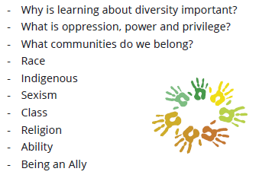
Why is this work important?
Personal and Social Competency
Definition
The Personal and Social competency is the set of abilities that relate to students' identity in the world, both as individuals and as members of their community and society. Personal and Social competency encompasses what students need to thrive as individuals, to understand and care about themselves and others, and to find and achieve their purposes in the world.
Personal Awareness and Responsibility
Positive Personal and Cultural Identity
Social Awareness and Responsibility
I don’t see this course specifically in the BC curriculum so why is this being offered in our schools?
Which core competencies is this course tied to?
Can you share the key themes of this course?
How will you assess success when this course ends?
Who is teaching and did they attend training? Will there be adjustments for things that went well or should be changed?
Notes:
What is identity and why is it key for students?
How long is the course? Is it for grades?
Staff being neural and leaving their personal beliefs at the door seems like it would be key in building a safe space for students to explore their own identity and not feel pressured to agree with their teacher. What instruction has staff been given with regards to presenting the information in a neutral way? Has this been successful thus far?

Slide 6
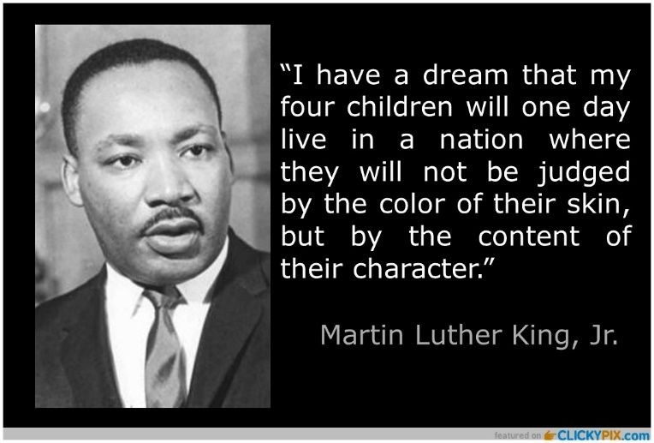
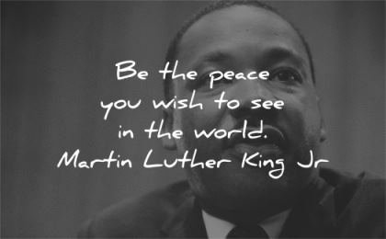
What do we hope to achieve?
Is there any justification that provides information on the possible positive impact of courses like this?
My sense is that this course may further divide students and our community rather than bringing them together.
Our family teaches about values at home, why do our kids have to learn this at school, as well?
Is there a space for the kids to have differing opinions?
We’re worried about the religious content in this course?
Notes:
How will you create a safe space for students to share their feelings and beliefs?
Will the focus be on how students are different or how they are the same?
Will my child be forced to share with the class?
My child has a strong sense of self, why attend this class?
Will topics be presented in a way to allow students to draw their own conclusion as a result of their personal experiences or will the beliefs of others be pushed on them?
I have some grave concerns about the content of this course. From the periphery, this class appears to a course targeted at social engineering and dividing people rather than teaching kindness, respect, and espousing the dream of Martin Luther King Jr. “"I have a dream that my four little children will one day live in a nation where they will not be judged by the color of their skin, but by the content of their character."
Why is this class teaching divisive theories like “Critical Race Theory”, which seeks to further divide people? Why are alternative viewpoints like the ideology of “Colour Blindness” not discussed?
Since when has issues like Religion and Sexual Orientation, private matters that should be discussed in the home, become the purview of public education?
Is there space for students to disagree with what is being taught and still be shown respect for their unique or diverse opinion? How would the teacher guide such a discussion? Or are they directed not to; but to allow the students to form their own opinion as a result of what they have heard?

Slide 7
Closing
In what ways can I as a parent stay connected to the content of this course?
Notes:
It seems the kids were not given any overview and don’t know what this class is about and why they are there, what they are going to learn? What kind of introduction were they given? More information would help them feel more at ease. Right now they don’t understand the point?
Will there be opportunity for the students to share what they are learning with their family?
Is there opportunity for the teacher to share course materials and videos with parents via teams?

